Slide 1
Linux device driver
Day 2 PPT
-SUBITHRA s

Slide 2
Data communication :
It is about how data is travelled from a source
Communication model structure
Communication Application:
Voice- Telephone, FAX etc
Video- TV, DVD etc
Data- LAN, WAN Internet,etc
Source
Transmitter
Transmission system
Receiver
Destination

Slide 3
NETWORK TOPOLOGY:
Bus topology - bus topology is a type of network topology in which all devices are connected to a single cable called a bus.
Star topology - a star topology is a type of network topology in which all the devices or nodes are physically connected to a central node such as a router, switch, or hub.
Ring topology - ring topology is a type of network configuration where devices are connected in a Circular manner, forming a closed loop
Fully connected topology - in this topology, every node is connected using a separate physical link
Combined topology – in this type of network topology in which two or more different topologies are integrated or combined to lay out a network.

Slide 4
PROTOCOL:
Set of rules to be implemented for exchanging messages from both sender and receiver side
Key elements of Protocol:
Syntax: Data formats ,signal level
Semantics: Control info, error handling
Timing: Speed matching, sequencing

Slide 5
Protocol Architecture:
The piece of data is broken into modules
Eg. For transferring file
File transfer application
Communication service module
Network access module

Slide 6
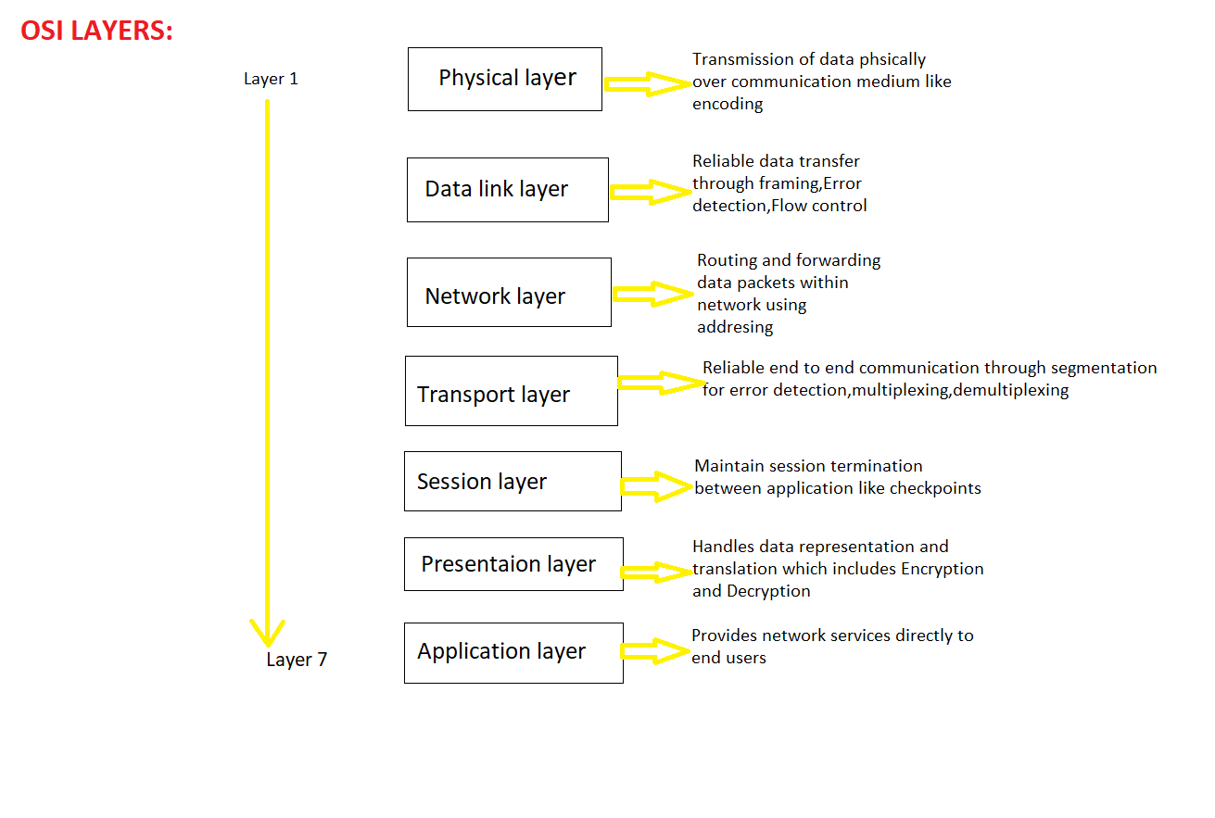
OSI Model
Open System Interconnection is a 7 layered structure which is developed by ISO

Slide 7
TCP/IP
Transmission Control Protocol/Internet Protocol describe the set of rules of how data should be transferrer between computers
These are used for communication via internet
It is implemented for LINUX,Windows etc
It is a part of OS

Slide 8
Tcp/ip protocol architecture
This Protocol is used by global internet
Application layer
Transport layer
Internet layer
Network access layer
Physical layer
Application
Application
TCP
TCP
IP
IP
NETWORK
Network
access
Network
access
Physical
Physical
Source system
Destination system

Slide 9
OSI VS TCP/IP
APPLICATION
PRESENTATION
SESSION
TRANSPORT
NETWORK
DATA LINK
PHYSICAL
APPLICATION
TRANSPORT
INTERNET
NETWORK ACCESS
PHYSICAL
SOFTWARE
USER SPACE
FIRMWARE
OS
HARDWARE

Slide 10
Computer NETWORK
A Computer Network is a network set up by connecting two or more computers and other supporting hardware devices through communication channels. A network enables computers to communicate with each other by sharing commands, data, etc, including hardware and software resources
TYPES:
LAN(Local Area Network)
WAN(Wide Area Network) etc

Slide 11
Connectivity and inter-networking: Point to point Broadcast links Switched Networks Connecting clouds

Slide 12
Building data networks
APPLICATION
TECHNOLOGY
WEB
E-mail
File sharing
Multimedia
Coaxial cable
Optical fibre
Wireless radio

Slide 13
PROTOCOLS AND INTERFACES
HOST A
HOST B
APPLICATION
PRESENTATION
SESSION
TRANSPORT
NETWORK
DATA LINK
PHYSICAL
APPLICATIONATION
PRESENTATION
SESSION
TRANSPORT
NETWORK
DATA LINK
PHYSICAL
ROUTER
NETWORK
DATA LINK
PHYSICAL

Slide 14
ADDRESSES AND NAMES
Hardware-lowest Level,ethernet
Network -IP, Etc
Transport-port Number In Tcp/Ip
Application Layer-name

Slide 15
IP ADDRESS
An internet protocol (IP) address is the unique identifying number assigned to every device connected to the internet. An IP address definition is a numeric label assigned to devices that use the internet to communicate. Computers that communicate over the internet or via local networks share information to a specific location using IP addresses.
NEED:
An IP address identifies every device connected to the internet. This enables computers and other internet-connected devices, such as mobile phones and internet-of-things (iot) devices, to communicate over the internet and on local-area networks (lans).

Slide 16
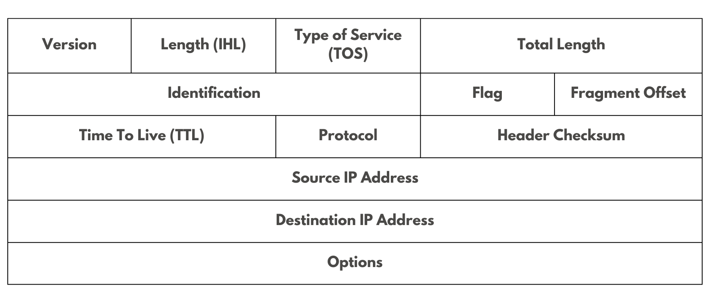
IP HEADER

Slide 17
Subnet
A subnet mask is a 32-bit number used in ipv4 ipv6 that divides your IP address into network and host portions. The network portion ensures that data packets reach the right network, while the host portion identifies a specific device on that network.

Slide 18
THANK YOU

